Slide 1
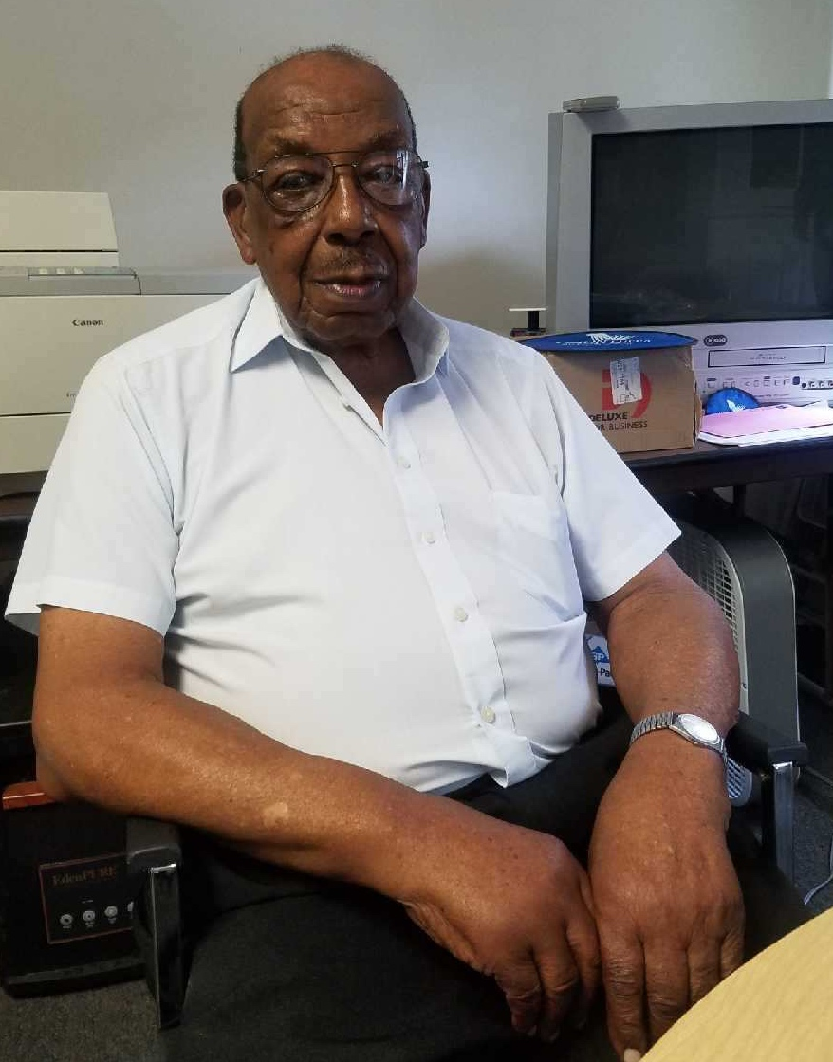
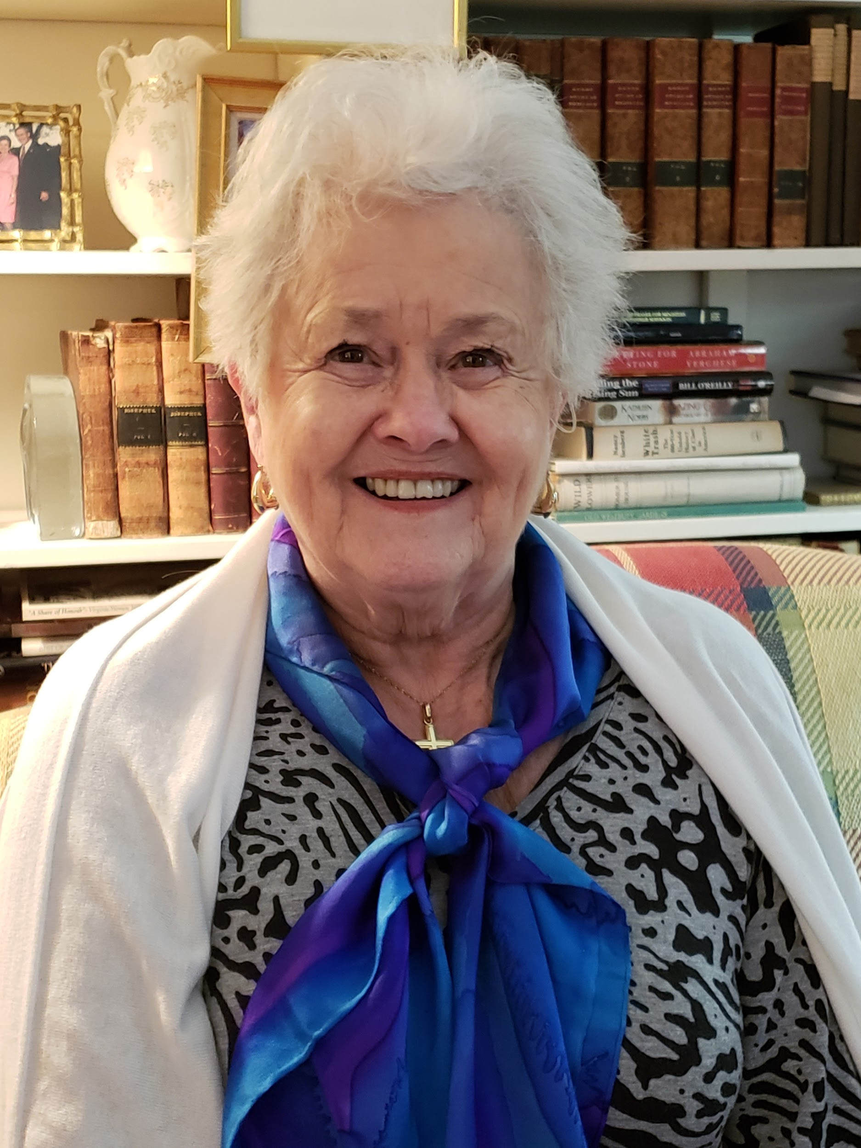
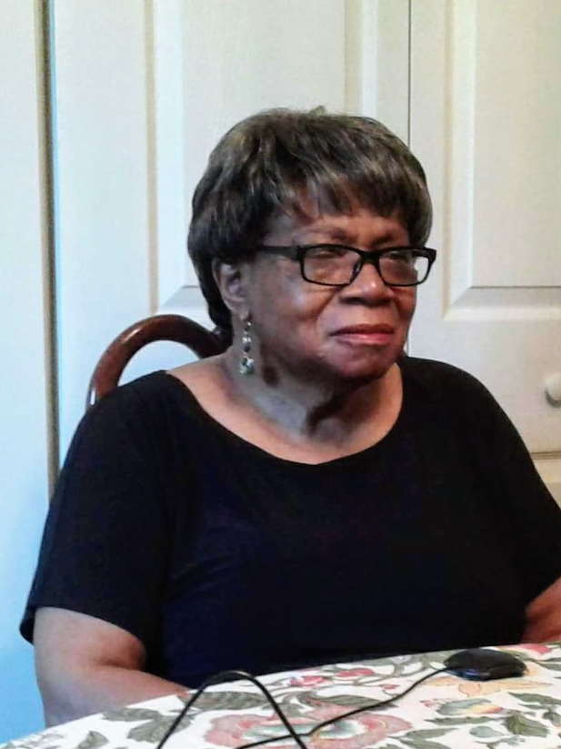
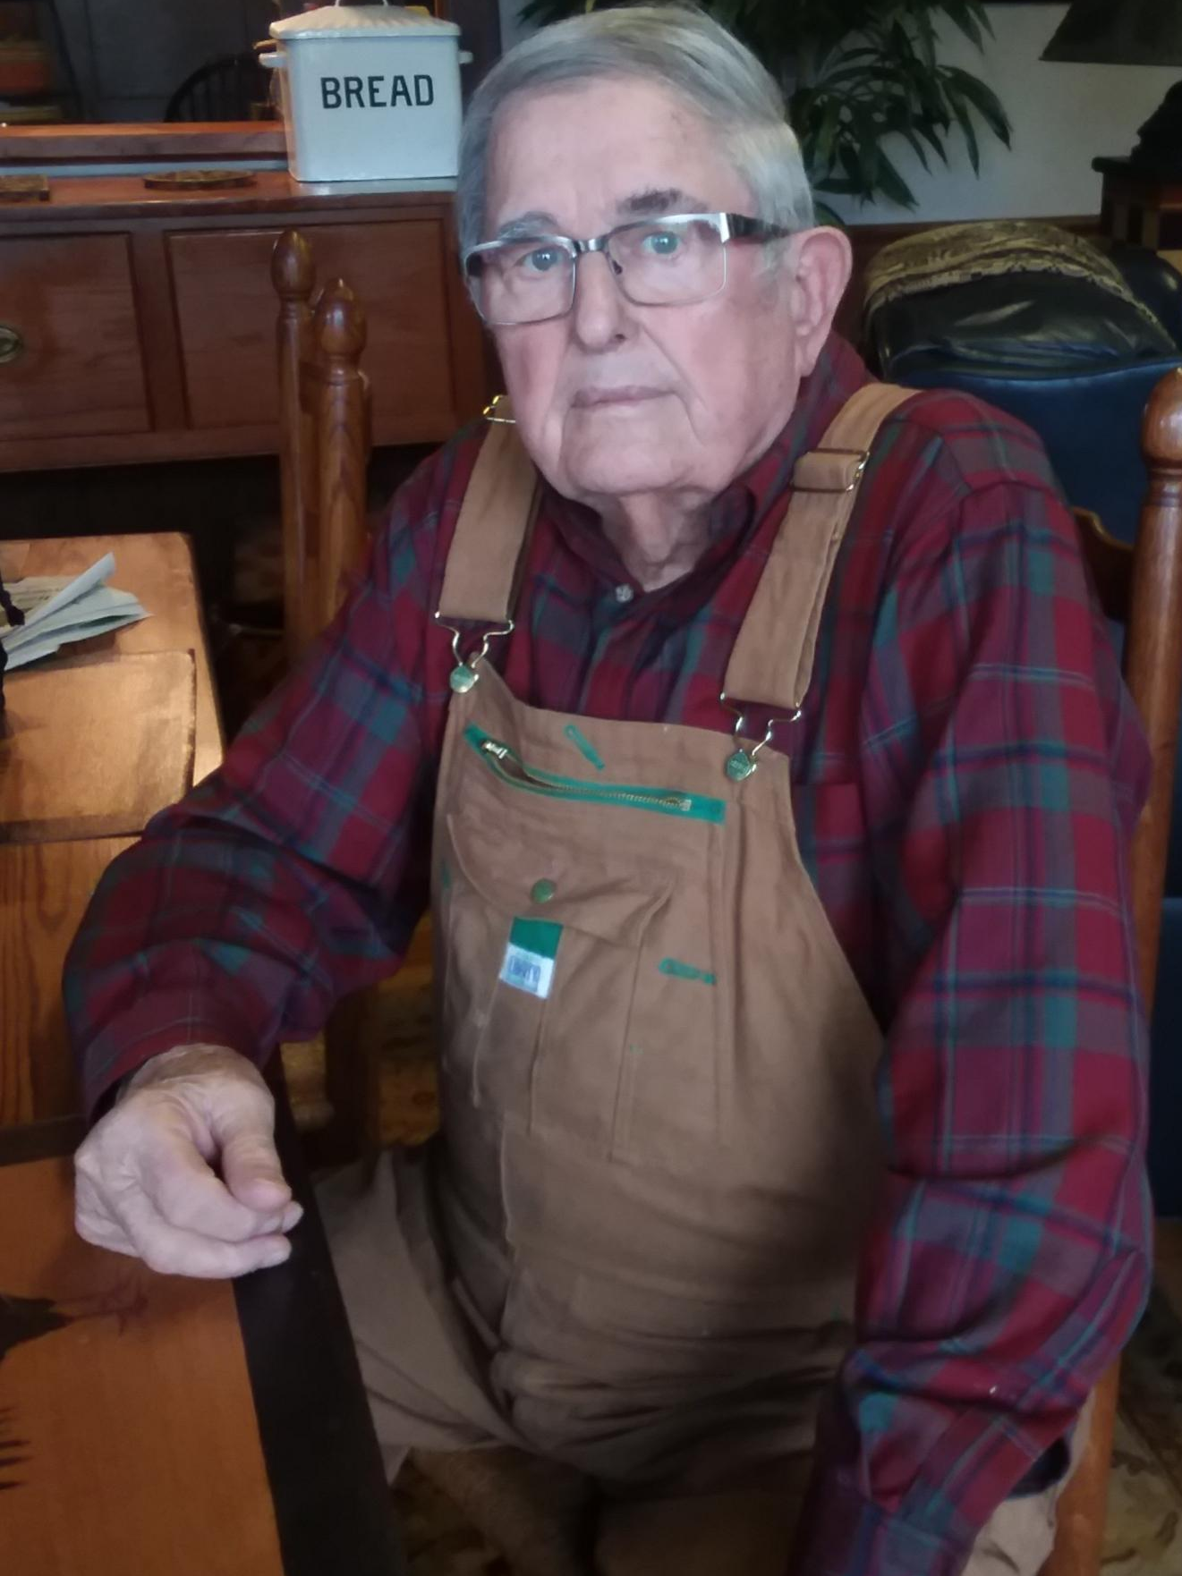
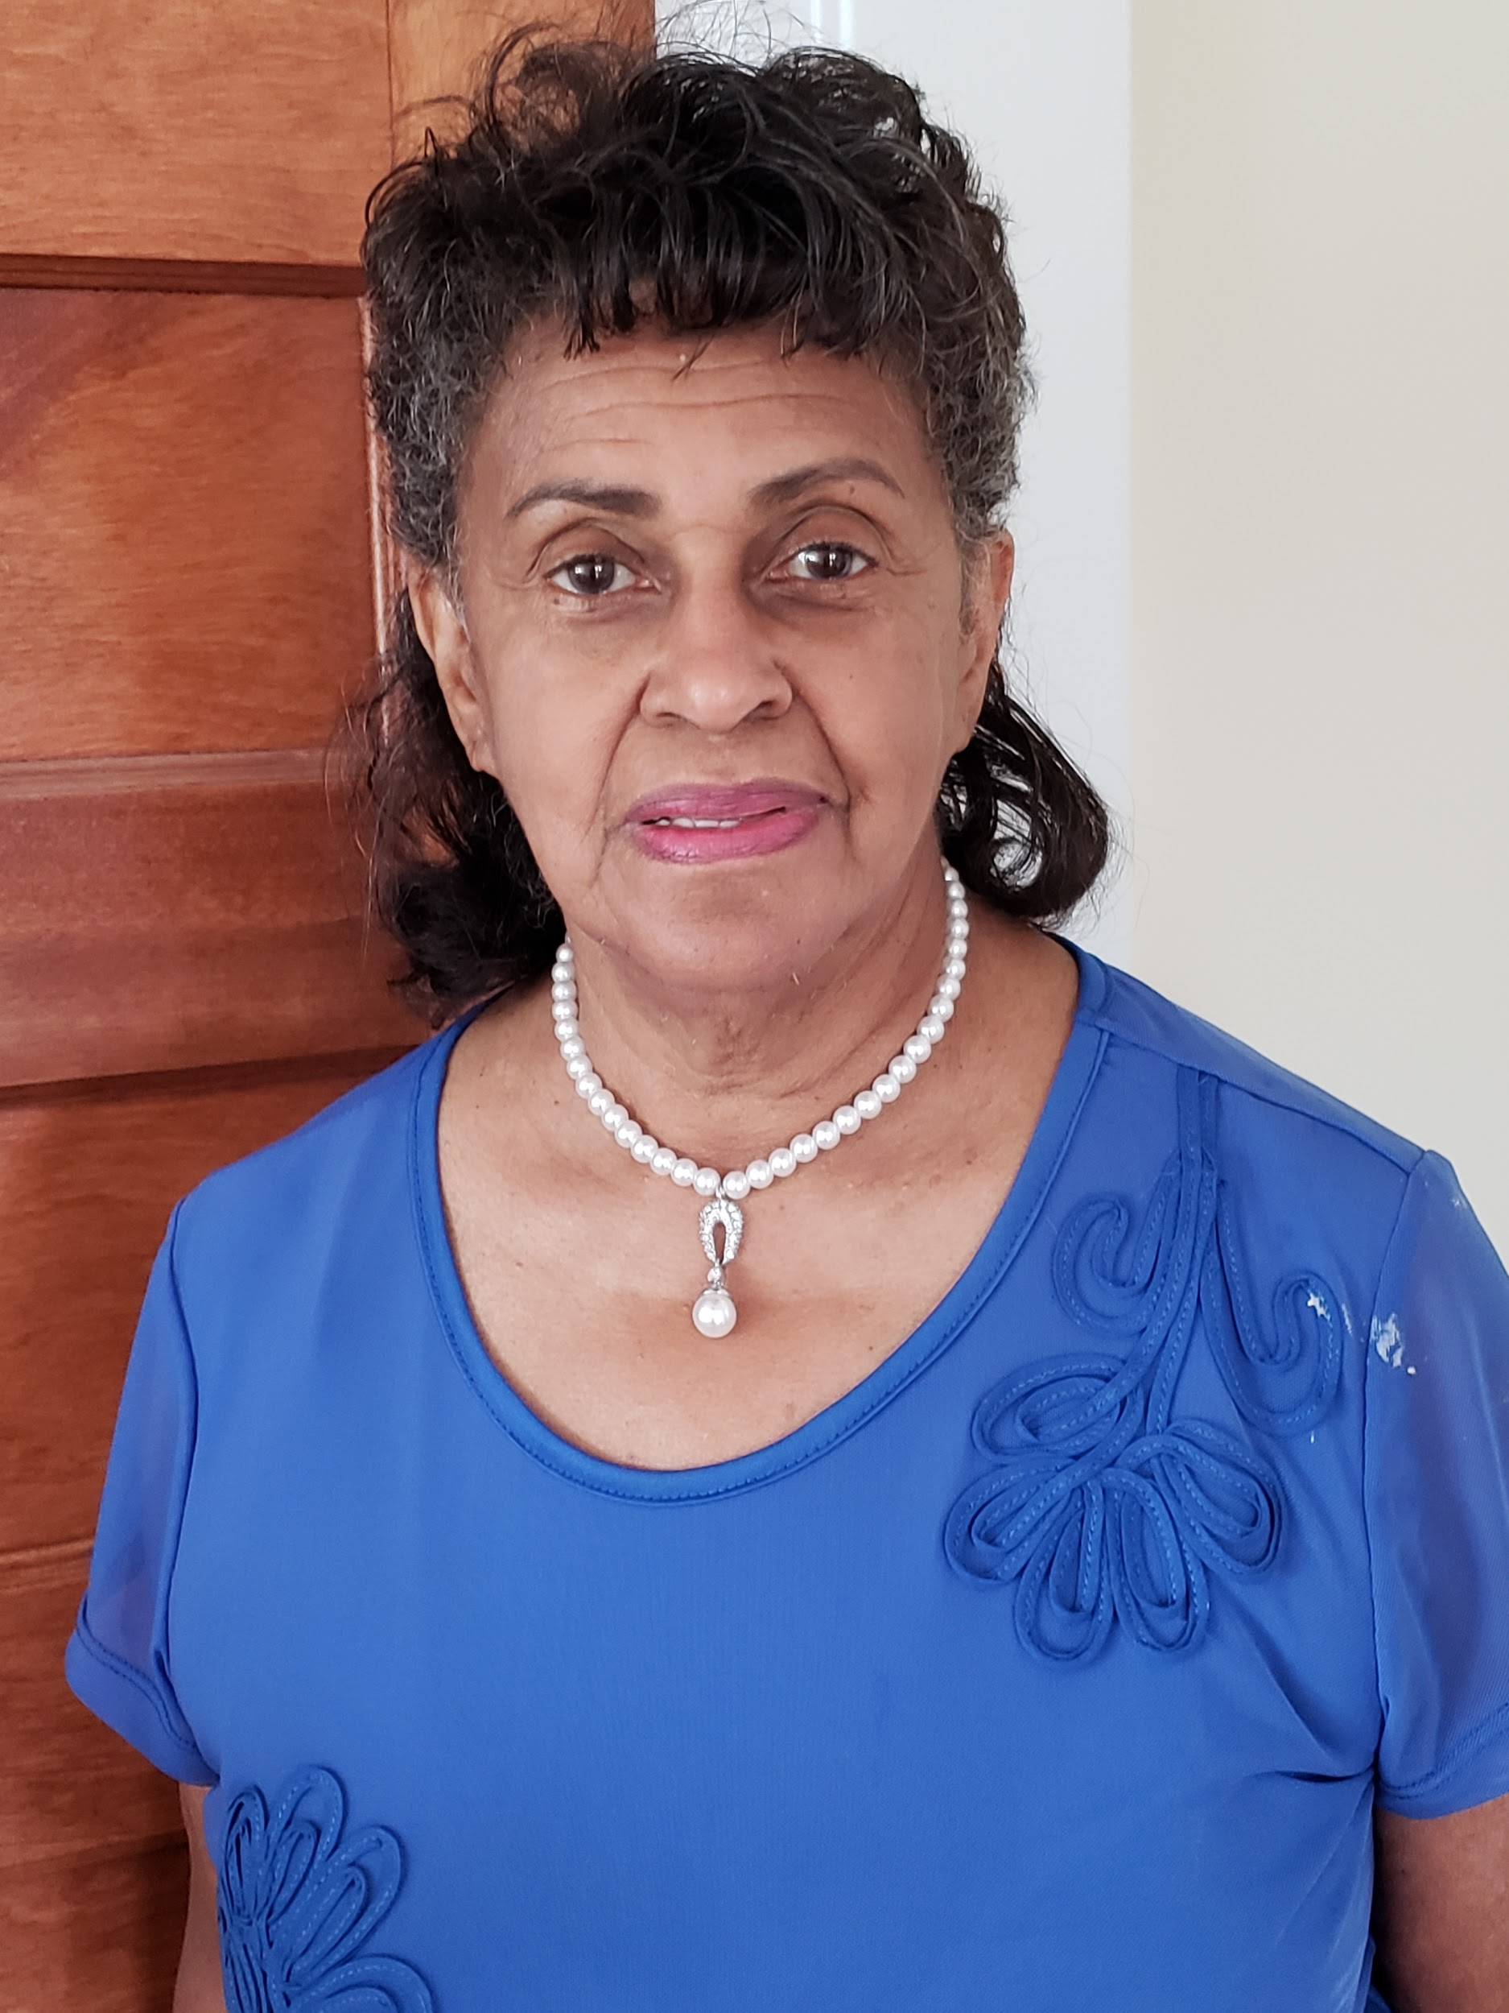
Many Voices, One Decade
1950s Louisa County
Exhibit Audio Companion
Louisa County Historical Society

Slide 2
“The whole world was afraid of polio”
Healthcare
Mrs. Jane Courtney describes an almost fatal health scare as a child and about her experience as a an African American at University of Virginia Hospital.
Dr. Jane Wootten talks about significant measures taken to protect against contracting polio.
Previous Slide: Education
Next Slide: Church

Slide 3
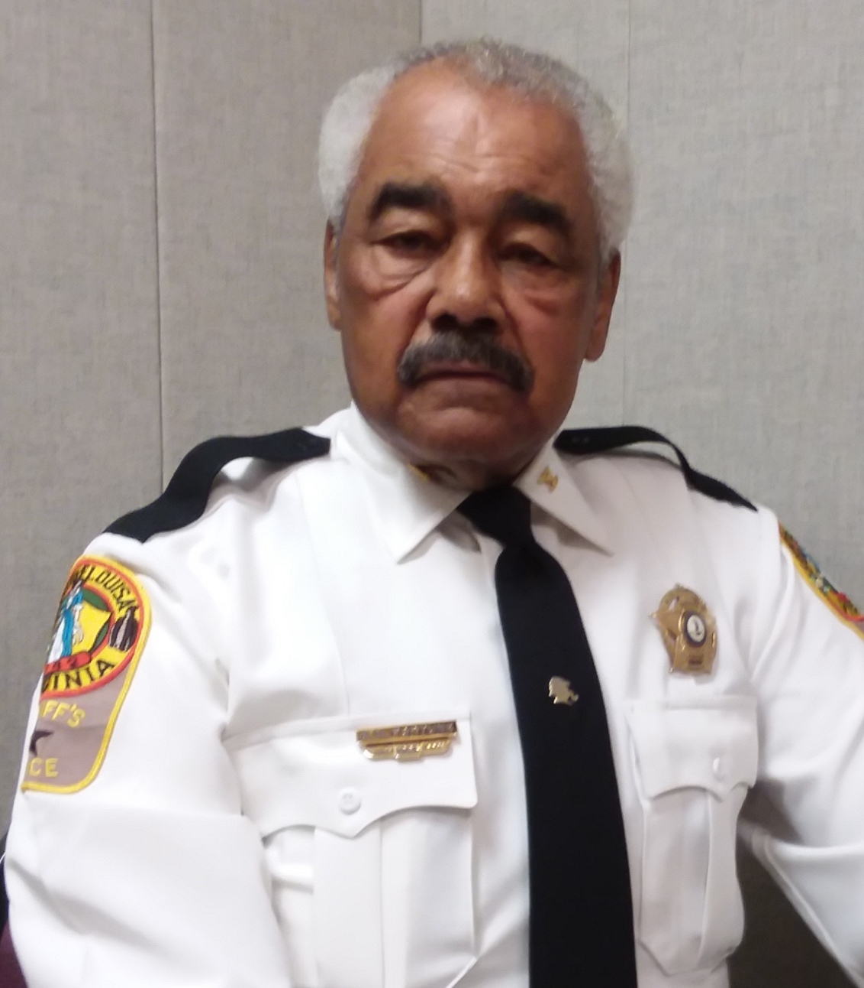
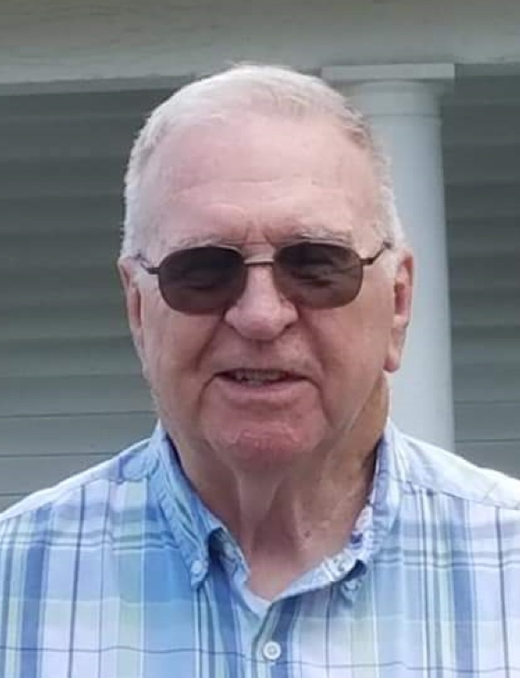
“See People As They Are”
Church
Sheriff Ashland Fortune tells us a story about the time he asked his mother why they were always the first to arrive at Church every Sunday.
In high school, Mr. Welford Sims helped with establishing a County youth fellowship program. He shares a story about holding fellowship meetings for youth living on the outskirts of Louisa County.
Previous Slide: Healthcare
Next Slide: Korean War

Slide 4
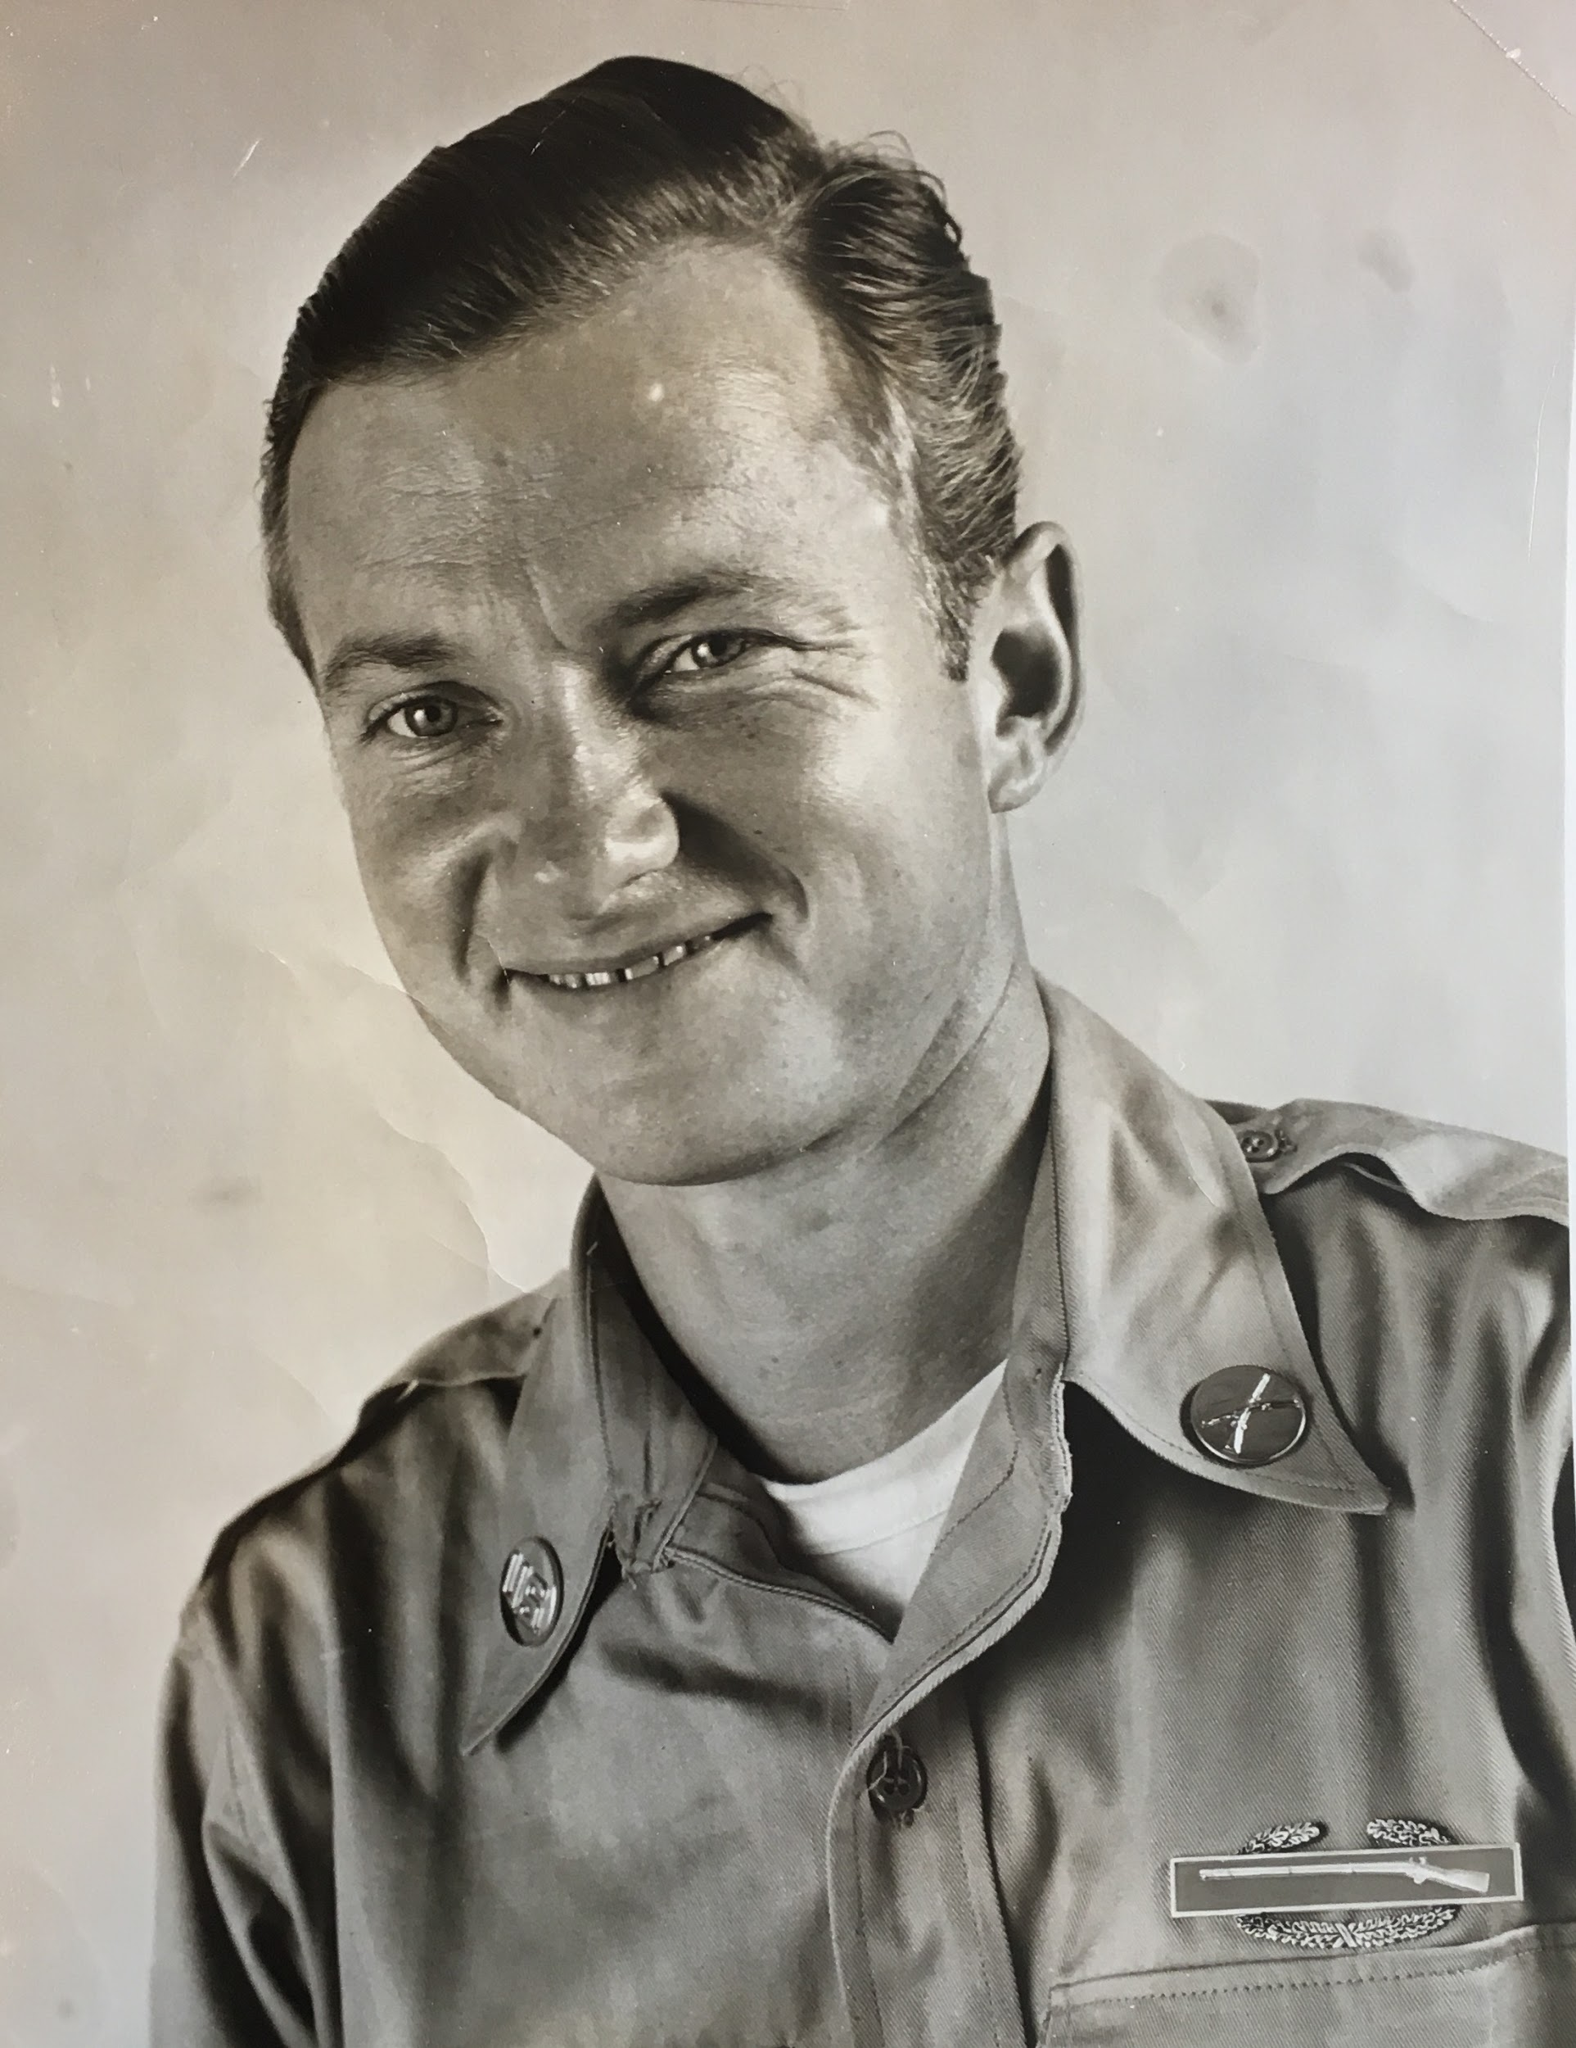
Jesse Thomas Hadder
Korean War Memorial
PFC Hadder was a rifleman in Co. F 35th Inf. 24th Div. He arrived in Korea on April 13, 1951 and was taken prisoner on April 25, 1951. He was a prisoner of war (POW) until August 12, 1953.
While held has a POW, PFC Hadder wrote many letters back home to Louisa County. The Hadder Family graciously donated original letters to the Louisa County Historical Society.
Press the speaker button below Mr. Hadder’s picture to listen to Louisa County Historical Society Board Member, John Purcell, read a letter written from a Korean POW camp to his mom and dad.
\
Previous Slide: Church
Next Slide: Movies

